Slide 1
Design for Verification Project Update
2021-06-07
Eldrick Millares, Jack Humphries (eldrick, jhumphri@stanford.edu)

Slide 2
Recap

Slide 3
Recap:
BOOM Deployment is difficult
Refocus on Steel
Expand ISA under test (e.g. jumps, branches)
CFCSS-V & CFTSS-V Checking
DFV on Small Designs
Why do we not see counterexamples?
Do we need to do any DFV for small designs?
How do we make small designs more interesting?

Slide 4
Recap:
What are other popular RISC-V cores?
Targets: ASPLOS (August), ISCA (November)

Slide 5
Control Flow Instructions for Steel

Slide 6
Refocus on Steel: Expand ISA Under Test
Expanded Mario’s tool to support jump instructions
Wrote a custom ISA config file for Steel

Slide 7
Refocus on Steel: CFCSS-V & CFTSS-V
Can now implement proposed control flow tests described in Appendix 1 of David Lin’s dissertation
CFCSS-V: Check that PC is a proper jump / branch target by comparing to address in imem
CFTSS-V: Check live/deadlock by counting instructions committed and adding total # of instructions committed property

Slide 8
External QED Module

Slide 9
Refocus on Steel: External QED Module
Idea: Move QED Instruction insertion from inside the processor to outside
How: QED Module inserts instructions into dual-ported instruction memory

Slide 10
Refocus on Steel: External QED Module
Why:
Simpler, less invasive integration with cores
Allows examination of processor front-end
Interesting Control Flow Checking

Slide 11
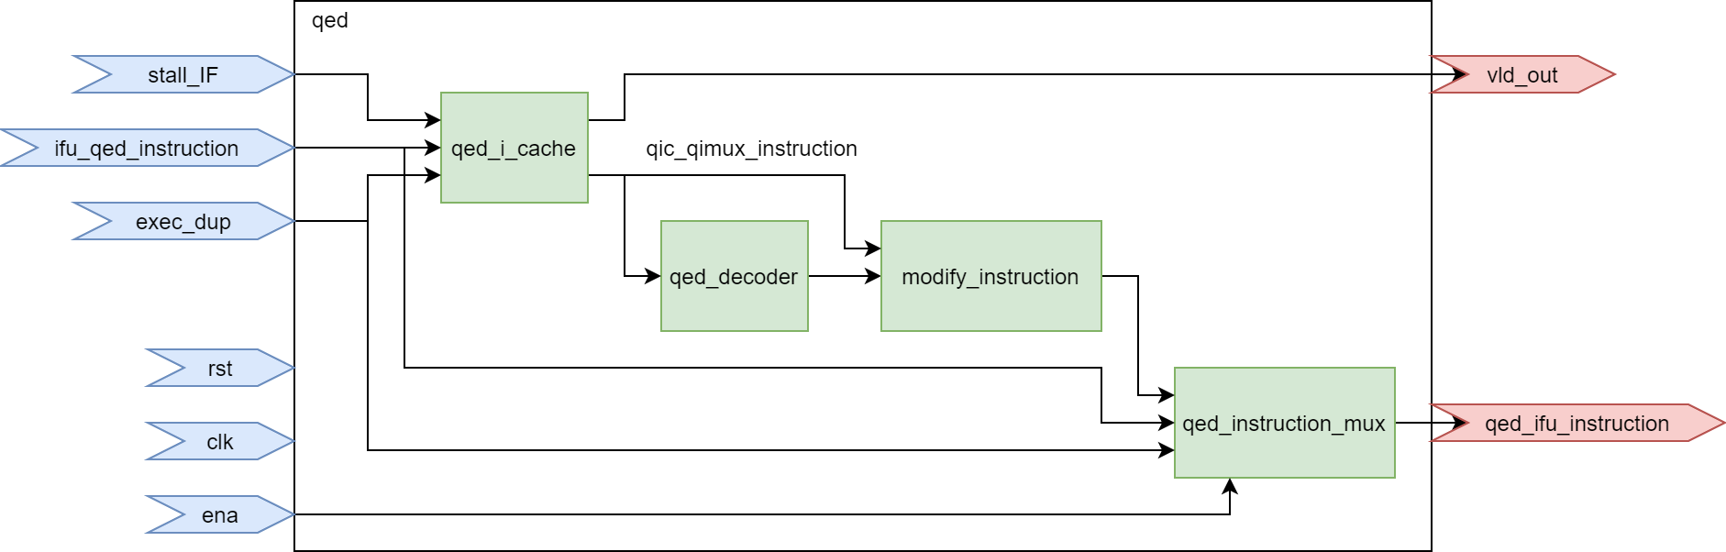
External QED: Simpler Integration
Current QED Module

Slide 12
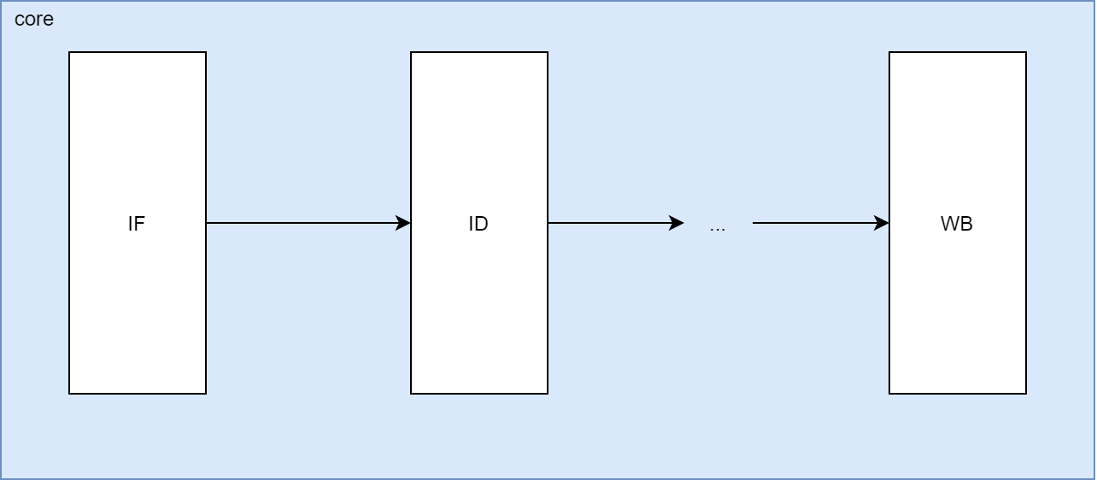
External QED: Simpler Integration

Slide 13
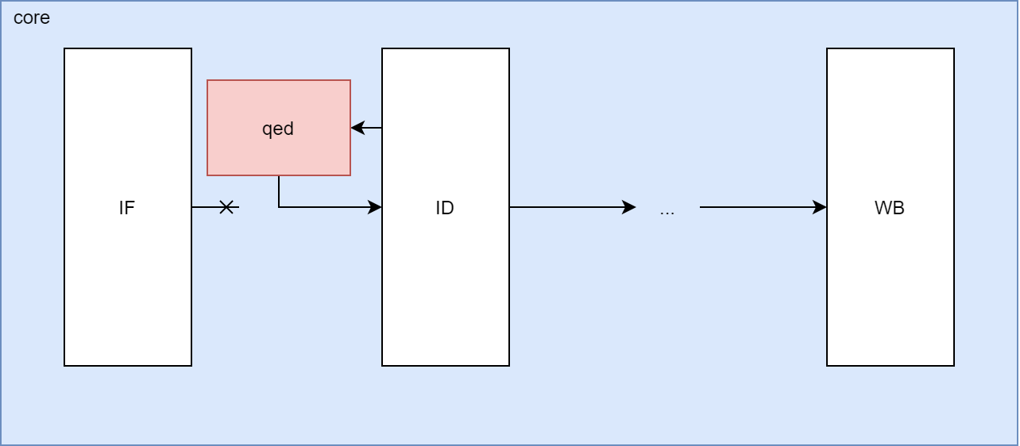
External QED: Simpler Integration

Slide 14
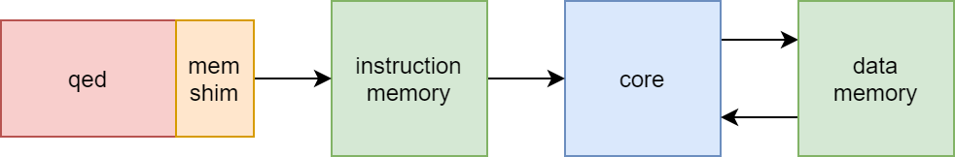
External QED: Simpler Integration

Slide 15
External QED: Simpler Integration

Slide 16
External QED: Simpler Integration

Slide 17
External QED: Simpler Integration

Slide 18
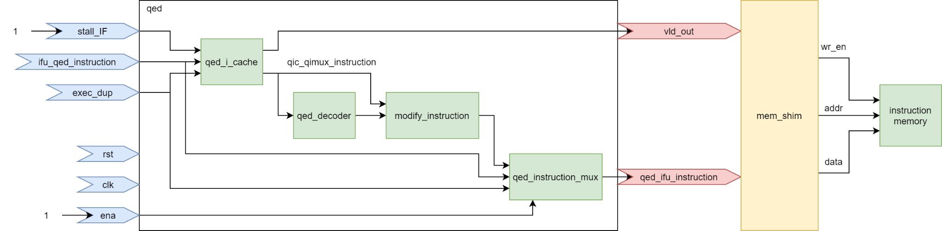
External QED: Simpler Integration

Slide 19
External QED: Simpler Integration
No need to modify design
No need to manage stall/flush signals
No extra modifications needed to QED module itself, just need to add shim

Slide 20
External QED: Front-End Checking
Allows us to exercise instruction fetch / front end

Slide 21
External QED: Control Flow Integration
Could create more interesting tests with control flow instructions since we can write anywhere in instruction address space
e.g. control flow checking using EDDI-V style tests only

Slide 22
Surveying Popular RISC-V Cores

Slide 23
Survey: Popular RISC-V Cores (Methodology)
Examined 107 cores published by riscv.org
https://riscv.org/exchange/cores-socs/
45 / 107 Cores are open source
Noted down # of GitHub stars for all open source cores as proxy for popularity

Slide 24
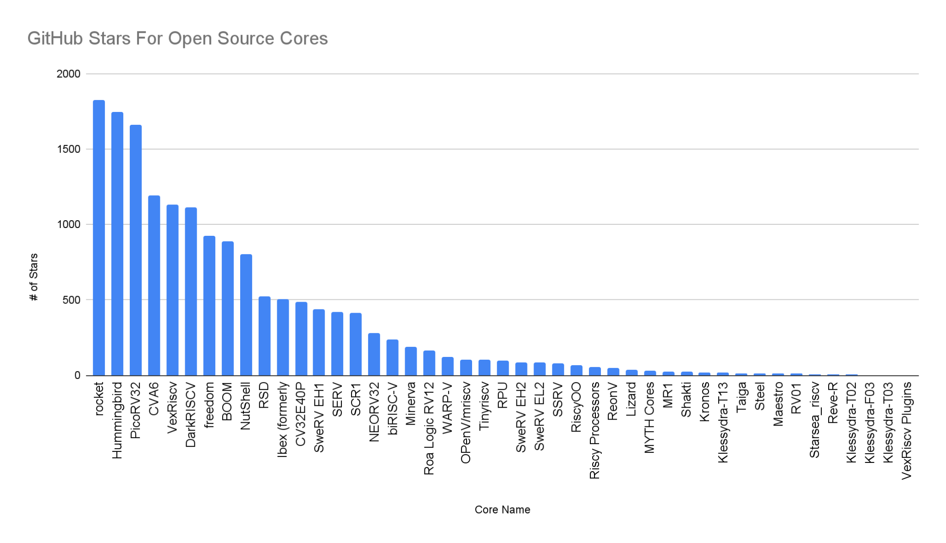

Slide 26
Survey: Popular RISC-V Cores (Top 10)
Links | Name | Stars | Primary Language | Capability | User spec
GitHub | rocket | 1823 | Chisel | RV32 | 2.3-draft
GitHub | Hummingbird E200 | 1748 | Verilog | RV32 | 2.2, RV32IMAC
GitHub | PicoRV32 | 1659 | Verilog | RV32 | RV32I/E[MC]
GitHub | CVA6 | 1194 | SystemVerilog | RV32,RV64 | RV[32/64]GC
GitHub | VexRiscv | 1132 | SpinalHDL | RV32 | RV32I/E[M][A][F[D]][C]
GitHub | DarkRISCV | 1115 | Verilog | RV32 | most of RV32I
GitHub | freedom | 923 | Chisel | RV32,RV64 | 2.3-draft
GitHub | BOOM | 889 | Chisel | RV64 | 2.3-draft
GitHub | NutShell | 801 | Chisel | RV64 | RV64IMAC
GitHub | RSD | 525 | SystemVerilog | RV32 | RV32IM

Slide 27
Survey: Popular RISC-V Cores (Top 10 - Verilog)
Links | Name | Stars | Primary Language | Capability | User spec
GitHub | rocket | 1823 | Chisel | RV32 | 2.3-draft
GitHub | Hummingbird E200 | 1748 | Verilog | RV32 | 2.2, RV32IMAC
GitHub | PicoRV32 | 1659 | Verilog | RV32 | RV32I/E[MC]
GitHub | CVA6 | 1194 | SystemVerilog | RV32,RV64 | RV[32/64]GC
GitHub | VexRiscv | 1132 | SpinalHDL | RV32 | RV32I/E[M][A][F[D]][C]
GitHub | DarkRISCV | 1115 | Verilog | RV32 | most of RV32I
GitHub | freedom | 923 | Chisel | RV32,RV64 | 2.3-draft
GitHub | BOOM | 889 | Chisel | RV64 | 2.3-draft
GitHub | NutShell | 801 | Chisel | RV64 | RV64IMAC
GitHub | RSD | 525 | SystemVerilog | RV32 | RV32IM
(AKA Ariane)

Slide 28
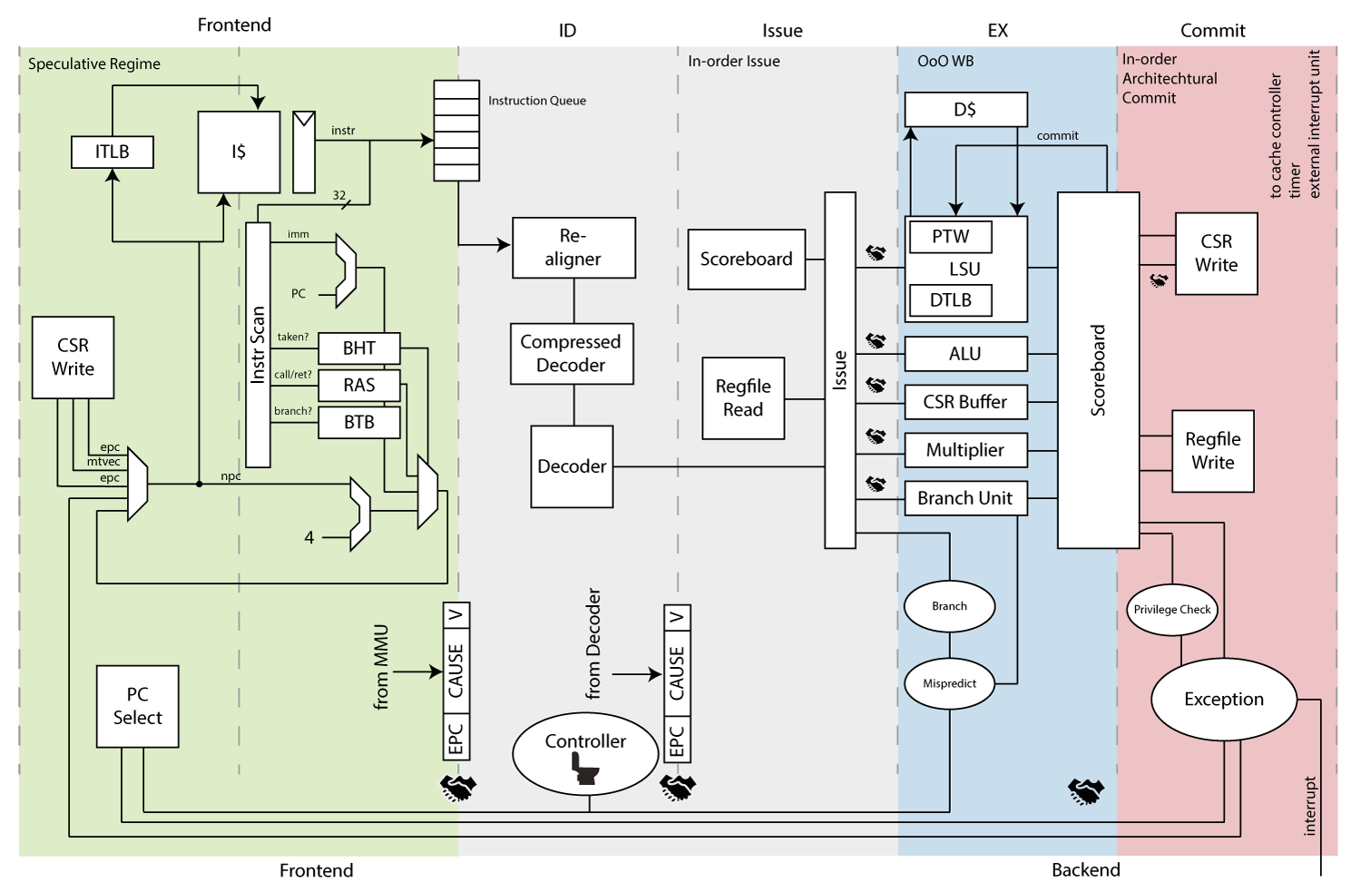
Survey: Popular RISC-V Cores (CVA6/Ariane)

Slide 29
Survey: Popular RISC-V Cores (CVA6/Ariane)

Slide 30
Survey: Popular RISC-V Cores (Summary)
CVA6 (Ariane) looks like a better fit for next core to deploy to than BOOM
Verilog Implementation
Similar Popularity
More Complex than Steel
Full Spreadsheet of Open Source RISC-V Cores here
https://docs.google.com/spreadsheets/d/1IlO1mJDA8dyojP3Ne51O2je-Olc6kYarzSvTAVcipf8/edit?usp=sharing

Slide 31
Case Study - Bugs Found By Other Formal Techniques

Slide 32
Case Study: Bugs found with riscv-formal
Question: Why do we not see bugs in our steel case study?
What kinds of bugs have other people found?

Slide 33
Case Study: Bugs found with riscv-formal
riscv-formal is a framework for formal verification of RISC-V processors.
Formal description of ISA spec
Formal TBs + Scripts to run Yosys Formal Flow

Slide 34
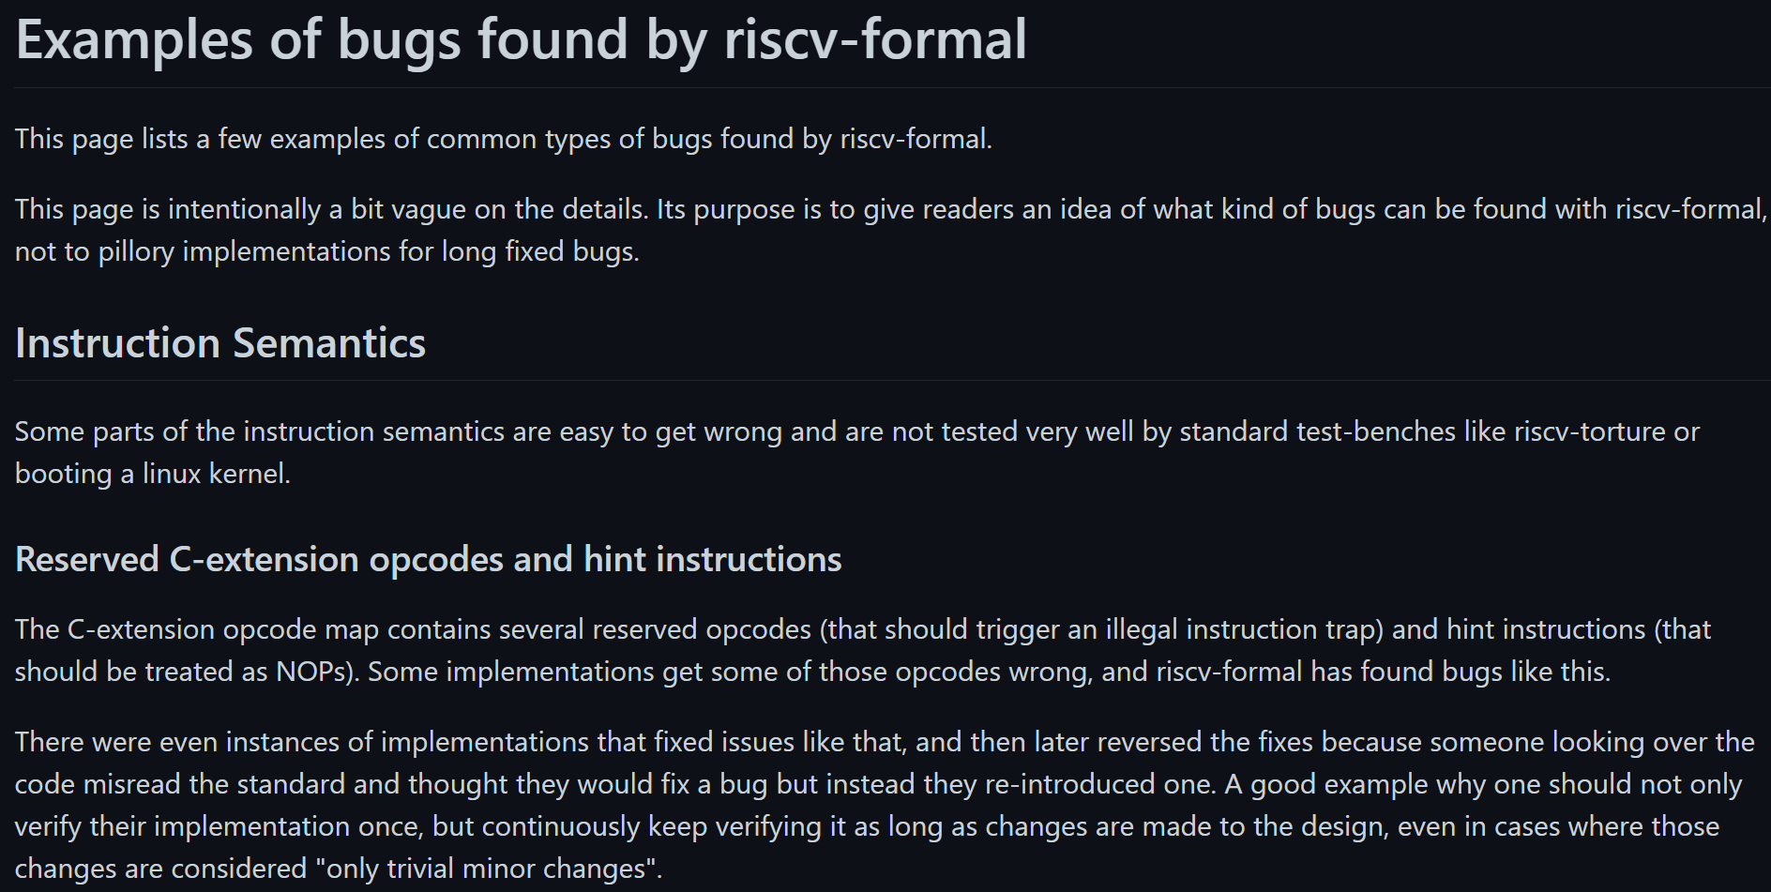

Slide 35
Summary - C-Extension Bug
Compressed Instruction Extensions
Each C instruction expands to single base I instruction
Confusion around permitted opcodes in the C-extension

Slide 36
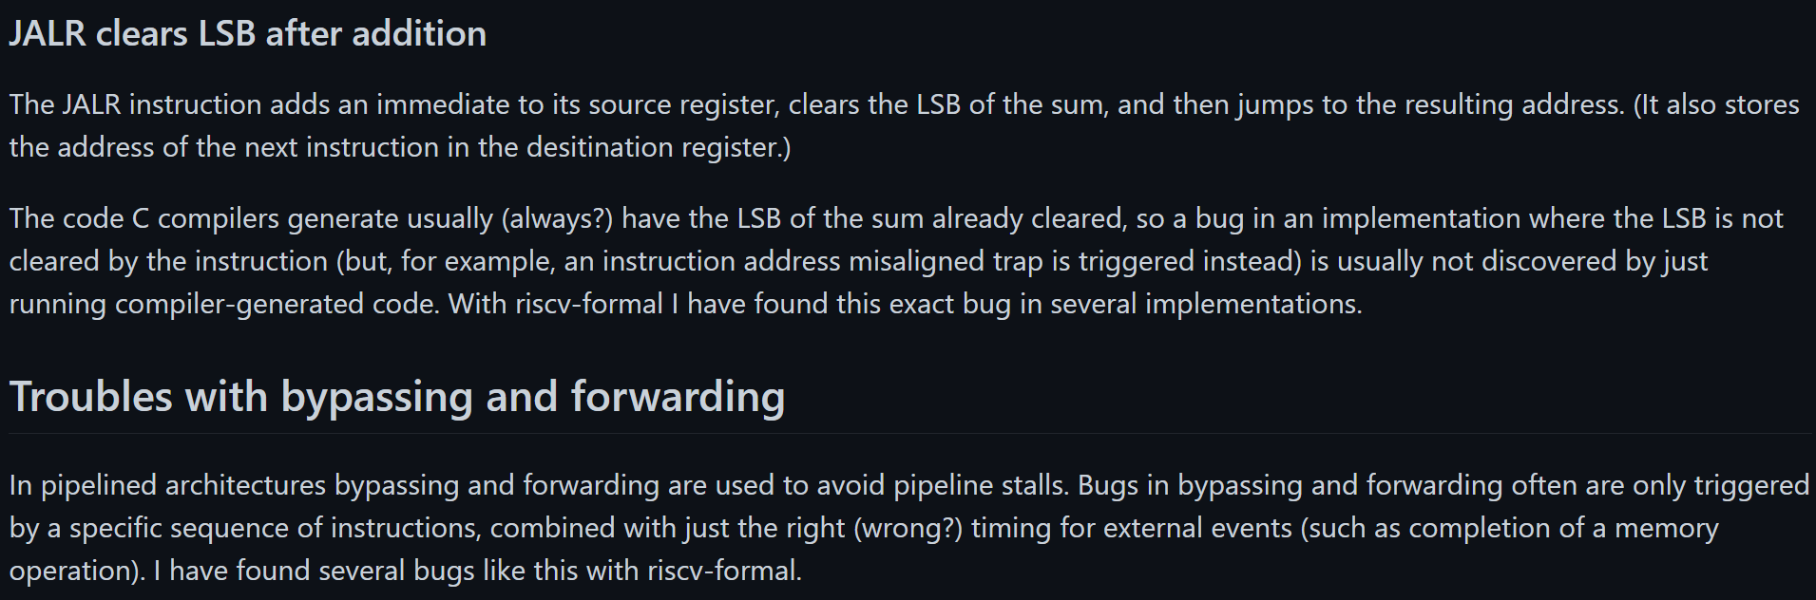

Slide 37
Summary - JALR Bug
Compiler-produced code enforces clearing of LSB for JALR (jump) instructions.
Avoids misaligned trap.
HW should also clear
If HW does not clear, can’t be found with tests that use compiler-produced code only

Slide 38
Summary - Forwarding
Many bugs in data forwarding

Slide 39
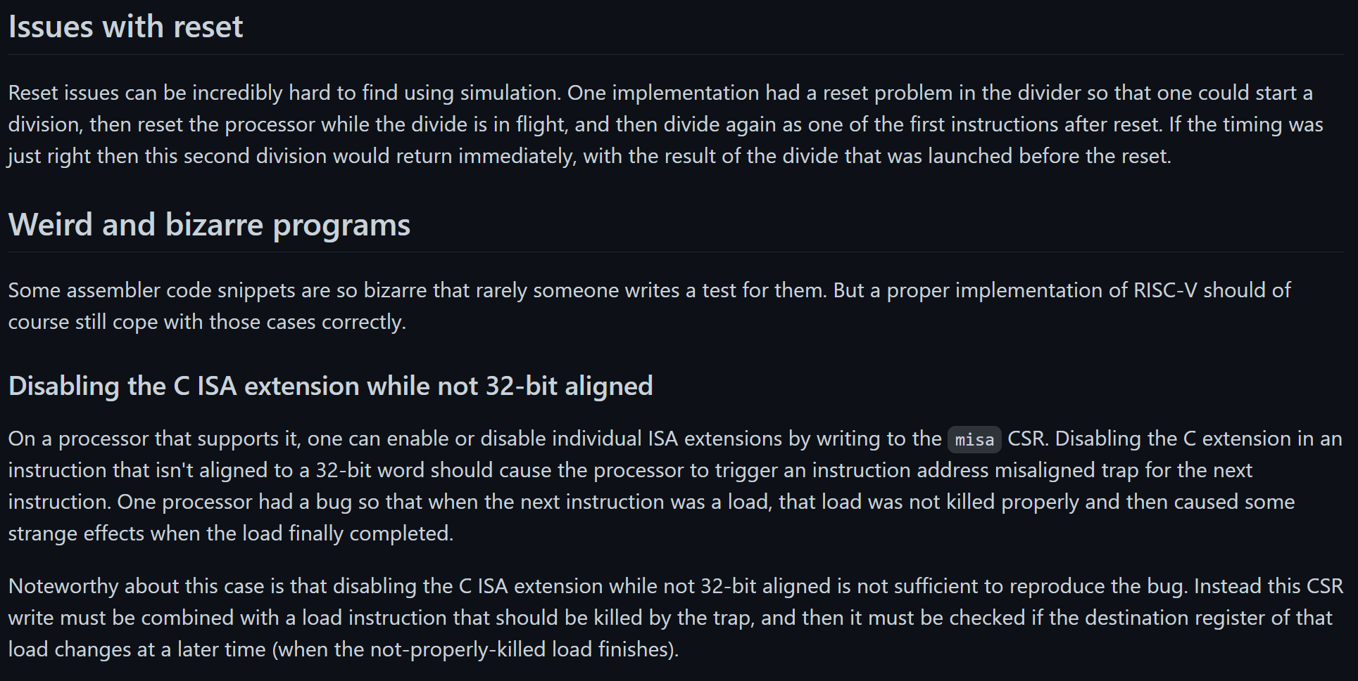

Slide 40
Summary - Resets
Result from division instruction before reset returns as result for division instruction after reset

Slide 41
Summary - Odd Behavior on enabling / disabling ISA extensions

Slide 42
Next Steps

Slide 43
Next Steps Summary
Expand Steel ISA under test to all control flow instructions
Implement external QED module
Integrate external QED module with Steel
Potentially back port external QED to v-scale, ridecore
Add CFCSS-V and CFTSS-V checking to Steel
Explore CVA6 deployment

Slide 44
Note
Reschedule Monday Meeting Times?

Slide 46
Stepping Up to Chisel-Based Designs
UCB-BAR has educational versions of Chisel-based cores called riscv-sodor
Offers 1/2/3/5 Stage Pipeline Versions
Could be used to stair-step up difficulty to BOOM

